Slide 1

Fact vs. Non-Fact Classification:
A Comparative Study of Pretrained & Fine-tuned Transformer Embeddings with Traditional ML Classifiers
Team No: 5
S.No. | Reg. No. | Name of the student
1 | BL.SC.U4AIE24149 | Srinithi Misha M
2 | BL.SC.U4AIE24134 | Navnita Krishnan
3 | BL.SC.U4AIE24152 | Trisha Radhakrishnan

Slide 2
Problem Statement
Given a sentence, predict whether it is a Fact (verifiable, empirically grounded) or a Non-Fact (opinion, subjective claim, or false statement).
Why it matters
Misinformation detection and automated fact-checking pipelines
Foundation for downstream NLP tasks like claim verification and knowledge base construction
Sentences are short and ambiguous — surface-level lexical features alone are insufficient; semantic understanding is required

Slide 3
Dataset
Custom scraped corpus — 1,338 sentences, two classes
Fact = 722
Non-Fact = 616
Length-stratified binning (6 bins: 0–5, 6–10, 11–15, 16–20, 21–30, 30+ words) to ensure bin-proportional resampling before train/test split
Fact = 571
Non-Fact = 616
80/20 stratified train-test split, fixed random_state=42

Slide 4
Methodology
Three-phase experimental design
Phase 1 — Baseline Embeddings
TF-IDF + Word2Vec → 7 classifiers each
Phase 2 — Pretrained Transformer Embeddings
BERT, T5, XLM-RoBERTa, SBERT, UniXcoder → 7 classifiers each
Pooling: attention-weighted mean of encoder last hidden states
Phase 3 — Fine-tuned Transformer Embeddings
Same 4 transformers fine-tuned on training set → 7 classifiers each
Classifiers tested: KNN, Decision Tree, Logistic Regression,
SVM (RBF/linear), XGBoost, CatBoost, LightGBM

Slide 5
Embeddings
Baseline
TF-IDF: Term frequency–inverse document frequency; captures lexical importance, no semantics
Word2Vec: Dense 300-dim word vectors; captures local co-occurrence semantics, averaged at sentence level
Pretrained Transformers
BERT (bert-base-uncased): Bidirectional encoder, 768-dim, fine-tuned on MLM + NSP
T5 (google/flan-t5-base): Encoder-decoder; only encoder used; instruction-tuned, 768-dim
XLM-RoBERTa (xlm-roberta-base): Multilingual BERT variant, robust to domain shift
SBERT (all-MiniLM): Sentence-BERT; optimised for sentence-level similarity
UniXcoder (microsoft/unixcoder-base): Unified cross-modal encoder; strong on structured/technical text
Fine-tuned variants (BERT-FT, T5-FT, XLM-FT, UniXcoder-FT): Encoders further trained on the classification task before feature extraction

Slide 6
Results
End-to-End Fine-Tuned Transformer Classifiers
 | Train |  | Test
Model | Accuracy | F1 Score | Accuracy | F1 Score
BERT (bert-base-uncased) | 0.98840885 | 0.98805646 | 0.915966387 | 0.918032787
T5 (google/flan-t5-base) | 0.97260274 | 0.97228145 | 0.932773109 | 0.933884298
XLM-RoBERTa (xlm-roberta-base) | 0.97787144 | 0.977346278 | 0.924369748 | 0.923728814
UniXcoder (microsoft/unixcoder-base) | 0.99157007 | 0.991189427 | 0.890756303 | 0.87254902

Slide 7
Results
KNN | BERT | 1 | 1 | 0.9118 | 0.9116
Decision Tree | BERT | 0.9389 | 0.9388 | 0.7857 | 0.7854
Logistic Regression | BERT | 1 | 1 | 0.937 | 0.9369
SVM | BERT | 0.9947 | 0.9947 | 0.9454 | 0.9454
XGBoost | BERT | 1 | 1 | 0.9286 | 0.9286
CatBoost | BERT | 1 | 1 | 0.9118 | 0.9116
LightGBM | BERT | 1 | 1 | 0.9412 | 0.9411
KNN | T5 | 1 | 1 | 0.916 | 0.916
Decision Tree | T5 | 0.9389 | 0.9388 | 0.8487 | 0.8487
Logistic Regression | T5 | 0.9895 | 0.9894 | 0.9454 | 0.9453
SVM | T5 | 1 | 1 | 0.958 | 0.958
XGBoost | T5 | 1 | 1 | 0.9328 | 0.9328
CatBoost | T5 | 1 | 1 | 0.9412 | 0.9411
LightGBM | T5 | 1 | 1 | 0.9454 | 0.9453
KNN | XLM | 0.9199 | 0.9193 | 0.8487 | 0.8481
Decision Tree | XLM | 0.8588 | 0.8579 | 0.7353 | 0.7318
Logistic Regression | XLM | 0.9874 | 0.9873 | 0.9202 | 0.92
SVM | XLM | 0.9842 | 0.9842 | 0.916 | 0.9157
XGBoost | XLM | 1 | 1 | 0.9076 | 0.9076
CatBoost | XLM | 1 | 1 | 0.8908 | 0.8906
LightGBM | XLM | 1 | 1 | 0.916 | 0.9158
KNN | UniXcoder | 0.9231 | 0.9224 | 0.8193 | 0.8166
Decision Tree | UniXcoder | 0.8809 | 0.8801 | 0.7017 | 0.7008
Logistic Regression | UniXcoder | 0.9779 | 0.9779 | 0.8824 | 0.8821
SVM | UniXcoder | 0.9989 | 0.9989 | 0.895 | 0.8945
XGBoost | UniXcoder | 1 | 1 | 0.8697 | 0.8695
CatBoost | UniXcoder | 1 | 1 | 0.8571 | 0.8565
LightGBM | UniXcoder | 1 | 1 | 0.8782 | 0.8778
Pretrained Embeddings
 |  | Train |  | Test
 |  | Accuracy | F1 Score | Accuracy | F1 Score
Model | Embedding
KNN | TF-IDF | 0.7703 | 0.7673 | 0.6891 | 0.6841
Decision Tree | TF-IDF | 0.6807 | 0.6374 | 0.6555 | 0.6116
Logistic Regression | TF-IDF | 0.764 | 0.7607 | 0.7185 | 0.713
SVM | TF-IDF | 0.7724 | 0.7698 | 0.7101 | 0.7051
XGBoost | TF-IDF | 0.6449 | 0.5933 | 0.6387 | 0.59
CatBoost | TF-IDF | 0.7987 | 0.7967 | 0.7185 | 0.7142
LightGBM | TF-IDF | 0.706 | 0.6896 | 0.6975 | 0.6811
KNN | Word2Vec | 1 | 1 | 0.6597 | 0.6579
Decision Tree | Word2Vec | 1 | 1 | 0.605 | 0.6046
Logistic Regression | Word2Vec | 0.7597 | 0.7597 | 0.7143 | 0.7103
SVM | Word2Vec | 0.843 | 0.843 | 0.7983 | 0.7976
XGBoost | Word2Vec | 0.9979 | 0.9979 | 0.6933 | 0.6932
CatBoost | Word2Vec | 0.9779 | 0.9778 | 0.7017 | 0.7005
LightGBM | Word2Vec | 1 | 1 | 0.6933 | 0.6926
KNN | SBERT | 1 | 1 | 0.8992 | 0.8992
Decision Tree | SBERT | 0.9989 | 0.9989 | 0.7185 | 0.7185
Logistic Regression | SBERT | 0.941 | 0.9409 | 0.9412 | 0.9411
SVM | SBERT | 1 | 1 | 0.9496 | 0.9495
XGBoost | SBERT | 0.9968 | 0.9968 | 0.8824 | 0.8819
CatBoost | SBERT | 1 | 1 | 0.916 | 0.9159
LightGBM | SBERT | 0.9926 | 0.9926 | 0.9118 | 0.9118

Slide 8
Results
Pretrained Embeddings

Slide 9
Results
Fine-tuned Embeddings
KNN | XLM-FT | 1 | 1 | 0.8739 | 0.8739
Decision Tree | XLM-FT | 0.9821 | 0.9821 | 0.8529 | 0.8528
Logistic Regression | XLM-FT | 1 | 1 | 0.9454 | 0.9453
SVM | XLM-FT | 1 | 1 | 0.9244 | 0.9241
XGBoost | XLM-FT | 1 | 1 | 0.895 | 0.8949
CatBoost | XLM-FT | 1 | 1 | 0.9076 | 0.9075
LightGBM | XLM-FT | 1 | 1 | 0.8992 | 0.899
KNN | UniXcoder-FT | 1 | 1 | 0.8992 | 0.8989
Decision Tree | UniXcoder-FT | 0.9663 | 0.9662 | 0.8109 | 0.8094
Logistic Regression | UniXcoder-FT | 0.9747 | 0.9747 | 0.9034 | 0.9031
SVM | UniXcoder-FT | 1 | 1 | 0.8824 | 0.8821
XGBoost | UniXcoder-FT | 1 | 1 | 0.8824 | 0.8821
CatBoost | UniXcoder-FT | 1 | 1 | 0.9076 | 0.9073
LightGBM | UniXcoder-FT | 0.9958 | 0.9958 | 0.8655 | 0.8649
 |  | Train |  | Test
 |  | Accuracy | F1 Score | Accuracy | F1 Score
Model | Embedding
KNN | BERT-FT | 0.9368 | 0.9367 | 0.937 | 0.9369
Decision Tree | BERT-FT | 0.9916 | 0.9916 | 0.8529 | 0.8522
Logistic Regression | BERT-FT | 0.9673 | 0.9673 | 0.9328 | 0.9328
SVM | BERT-FT | 1 | 1 | 0.9496 | 0.9495
XGBoost | BERT-FT | 0.9621 | 0.962 | 0.8908 | 0.8907
CatBoost | BERT-FT | 0.9842 | 0.9842 | 0.9076 | 0.9074
LightGBM | BERT-FT | 1 | 1 | 0.9076 | 0.9072
KNN | T5-FT | 1 | 1 | 0.8992 | 0.8992
Decision Tree | T5-FT | 1 | 1 | 0.8487 | 0.8487
Logistic Regression | T5-FT | 0.9916 | 0.9916 | 0.9454 | 0.9453
SVM | T5-FT | 1 | 1 | 0.9538 | 0.9537
XGBoost | T5-FT | 0.9905 | 0.9905 | 0.9286 | 0.9286
CatBoost | T5-FT | 1 | 1 | 0.9244 | 0.9244
LightGBM | T5-FT | 1 | 1 | 0.937 | 0.937

Slide 10
Results
Fine-tuned Embeddings

Slide 11
Final Model
Chosen Model: SVM + T5 Pretrained
T5's instruction-tuning (flan-t5-base) encodes factual vs. non-factual distinctions in its latent space better than other transformers tested
Frozen encoder preserves generalisation — no catastrophic forgetting on small data
Test Accuracy | 95.80%
Macro F1-Score | 95.80%
Embedding dim | 768
Tuning | RandomizedSearchCV, 3-fold CV

Slide 12
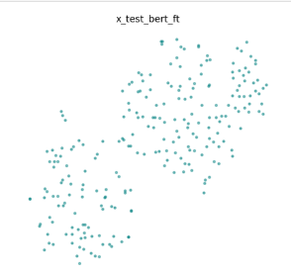
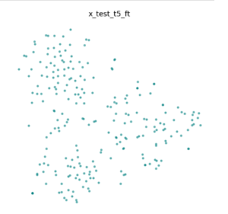
t-SNE Visualization of Embeddings
All 11 embedding variants (7 pretrained + 4 fine-tuned) were saved as .npy files and visualised using t-SNE (t-distributed Stochastic Neighbour Embedding) reduced to 2D — one plot per embedding in a grid layout (perplexity = min(30, n_samples − 1), random_state=42).
t-SNE projects high-dimensional embeddings (e.g. 768-dim T5 vectors) into 2D while preserving local neighbourhood structure — visually revealing whether the two classes (Fact / Non-Fact) form separable clusters in the learned representation space.

Slide 13
LIME Pipeline
Accuracy only tells us if the model is right — not what it looked at to make that decision. LIME helps us peek inside the black box by highlighting which words in a sentence pushed the model toward Fact or Non-Fact
Applied to top 5 model combinations ranked by test performance:
Rank | Model | Test Acc
1 | SVM + T5 (pretrained) | 95.80%
2 | SVM + T5-FT | 95.38%
3 | SVM + SBERT | 94.96%
4 | SVM + BERT-FT | 94.96%
5 | LR + XLM-FT | 94.54%

Slide 14
LIME Pipeline
Example — "India launched the Ayushman Bharat scheme in 2018 to provide health insurance coverage to low-income families." (True label: Fact)
Model | Prediction | P(Fact) | Top positive signals
SVM + T5 | Fact | 0.996 | launched, provide, coverage, insurance
SVM + T5-FT | Fact | 0.996 | insurance, launched, provide, 2018
SVM + SBERT | Fact | 0.983 | launched, India, scheme, insurance
SVM + BERT-FT | Non-Fact | 0.142 | Negative: India, 2018, health, families
LR + XLM-FT | Fact | 0.881 | income, provide, scheme

Slide 15
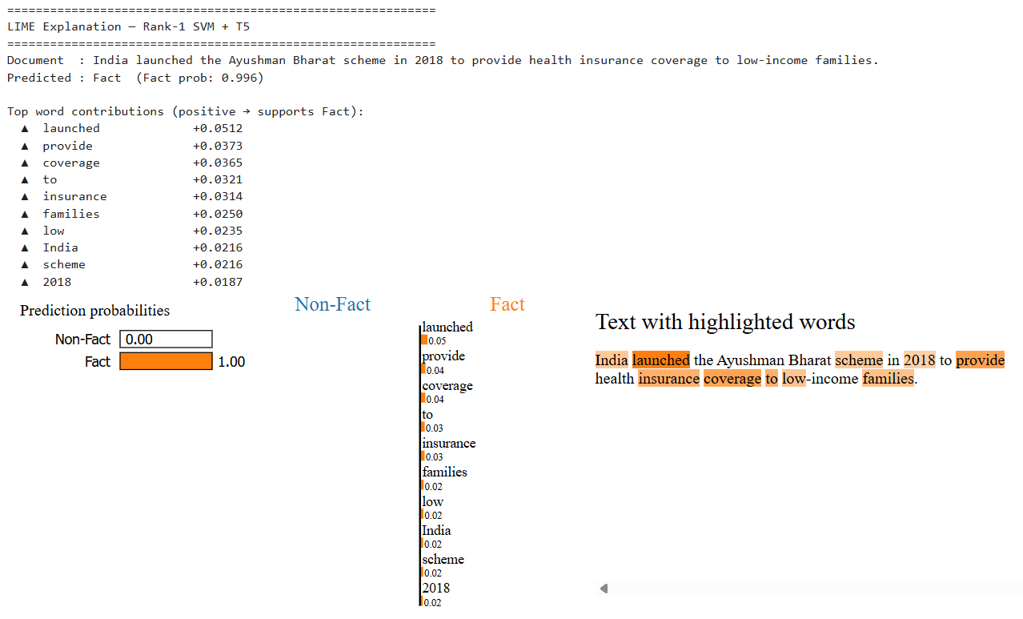
LIME Pipeline

Slide 16

LIME Pipeline

Slide 17
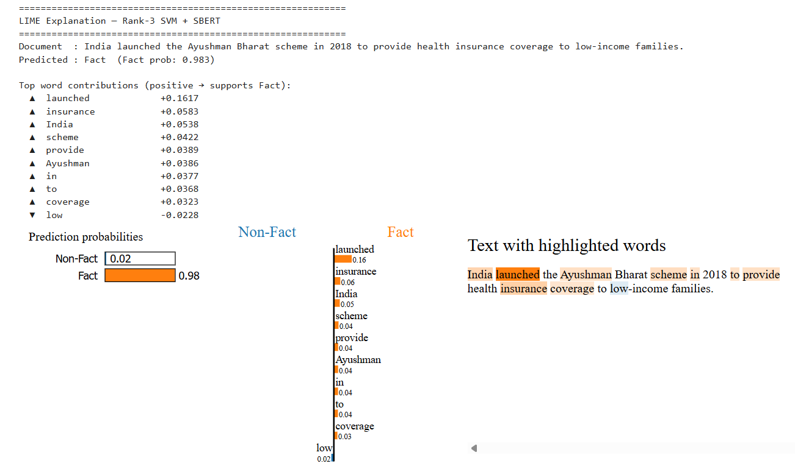
LIME Pipeline

Slide 18
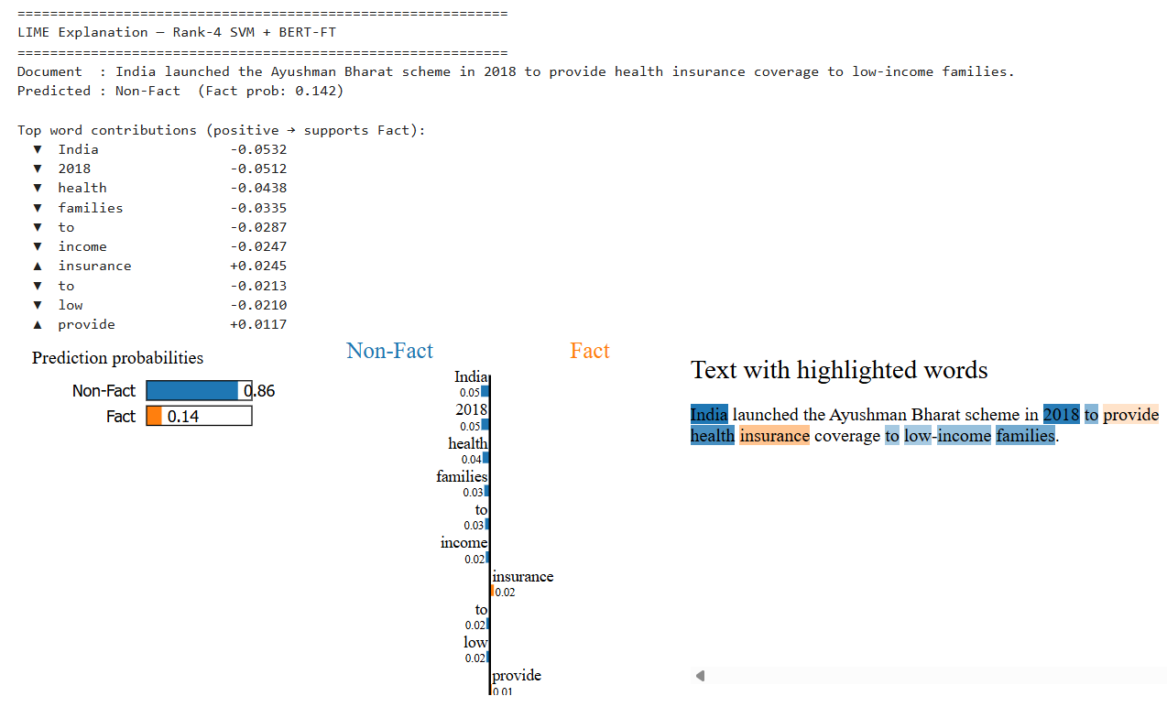
LIME Pipeline

Slide 19
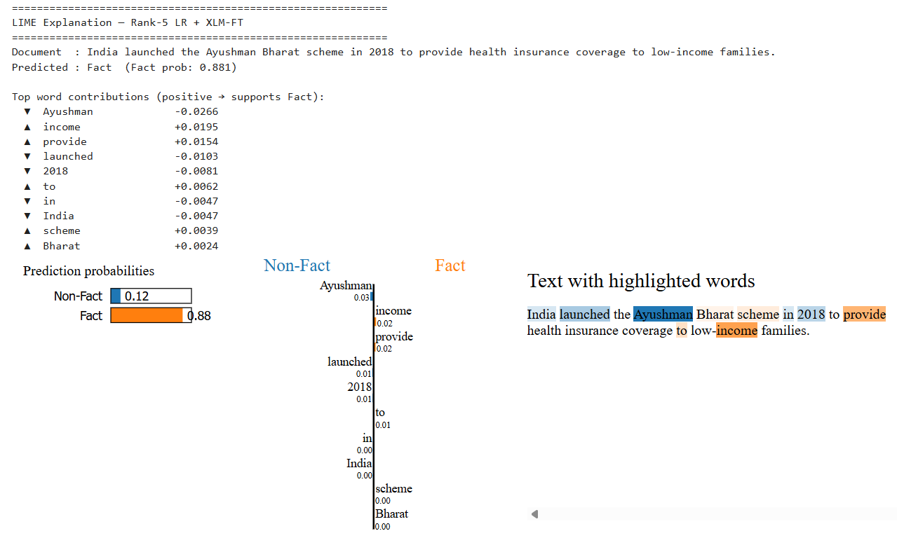
LIME Pipeline

Slide 20
Thank You !

